Slide 1


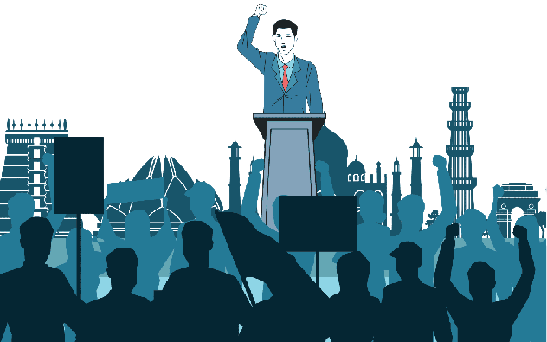

Political Party Social Media Analysis- Tamil Nadu BJP Political party & Politicians

Slide 2
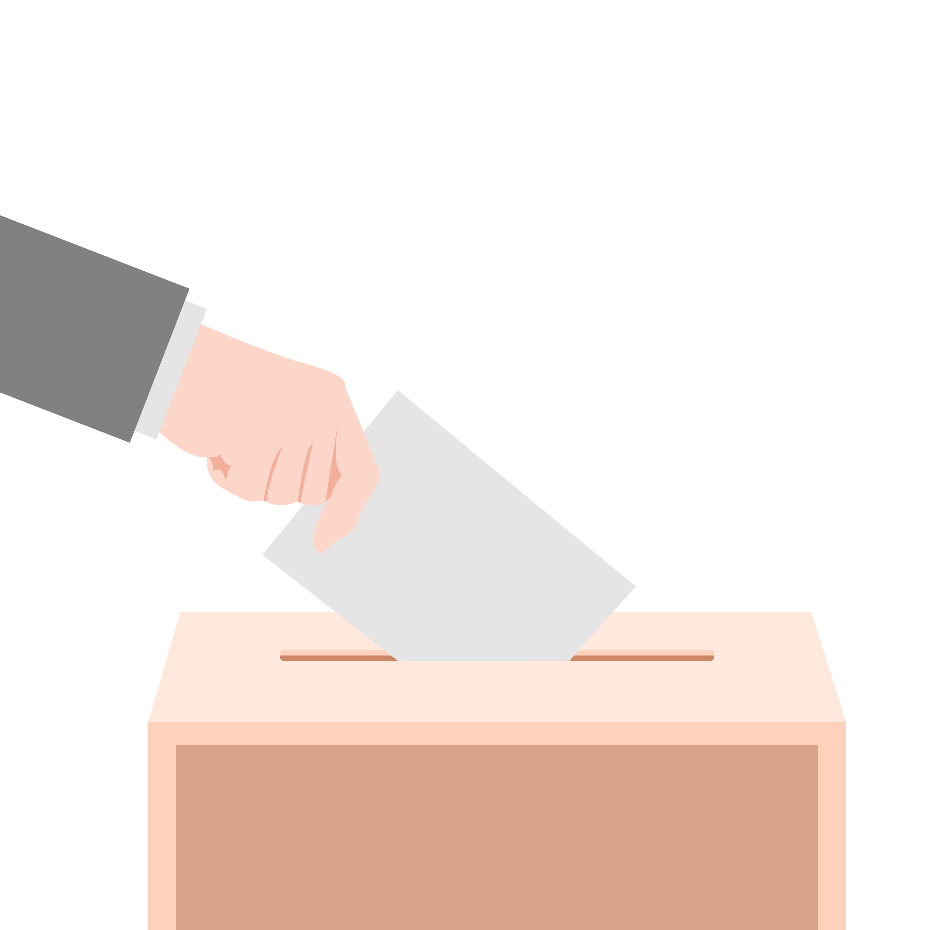

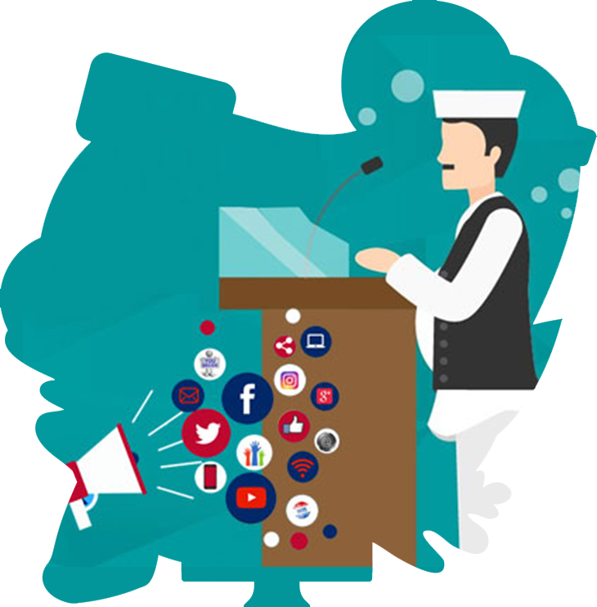
GENERAL STATISTICS
16% of all registered voters follow political candidates, parties and politicians on social media
39% of adult have used social media in some way involving civic/political activities
25% of social network users became more active about a political issue after engaging with it on a social networking site

Slide 3

Why this dataset ?
Opposition parties of BJP have the opinion that BJP cannot get good support from Tamil Nadu. To Analyse about this public opinion, I took social media to check whether BJP got good reach or not?

Slide 4

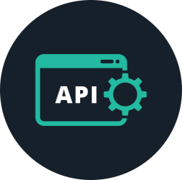
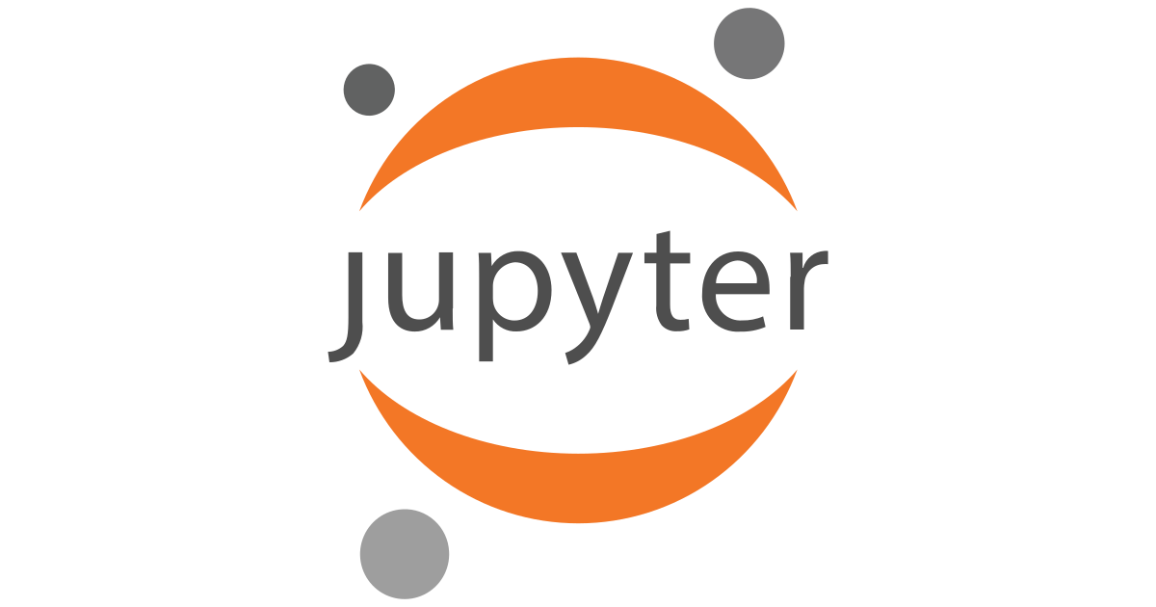
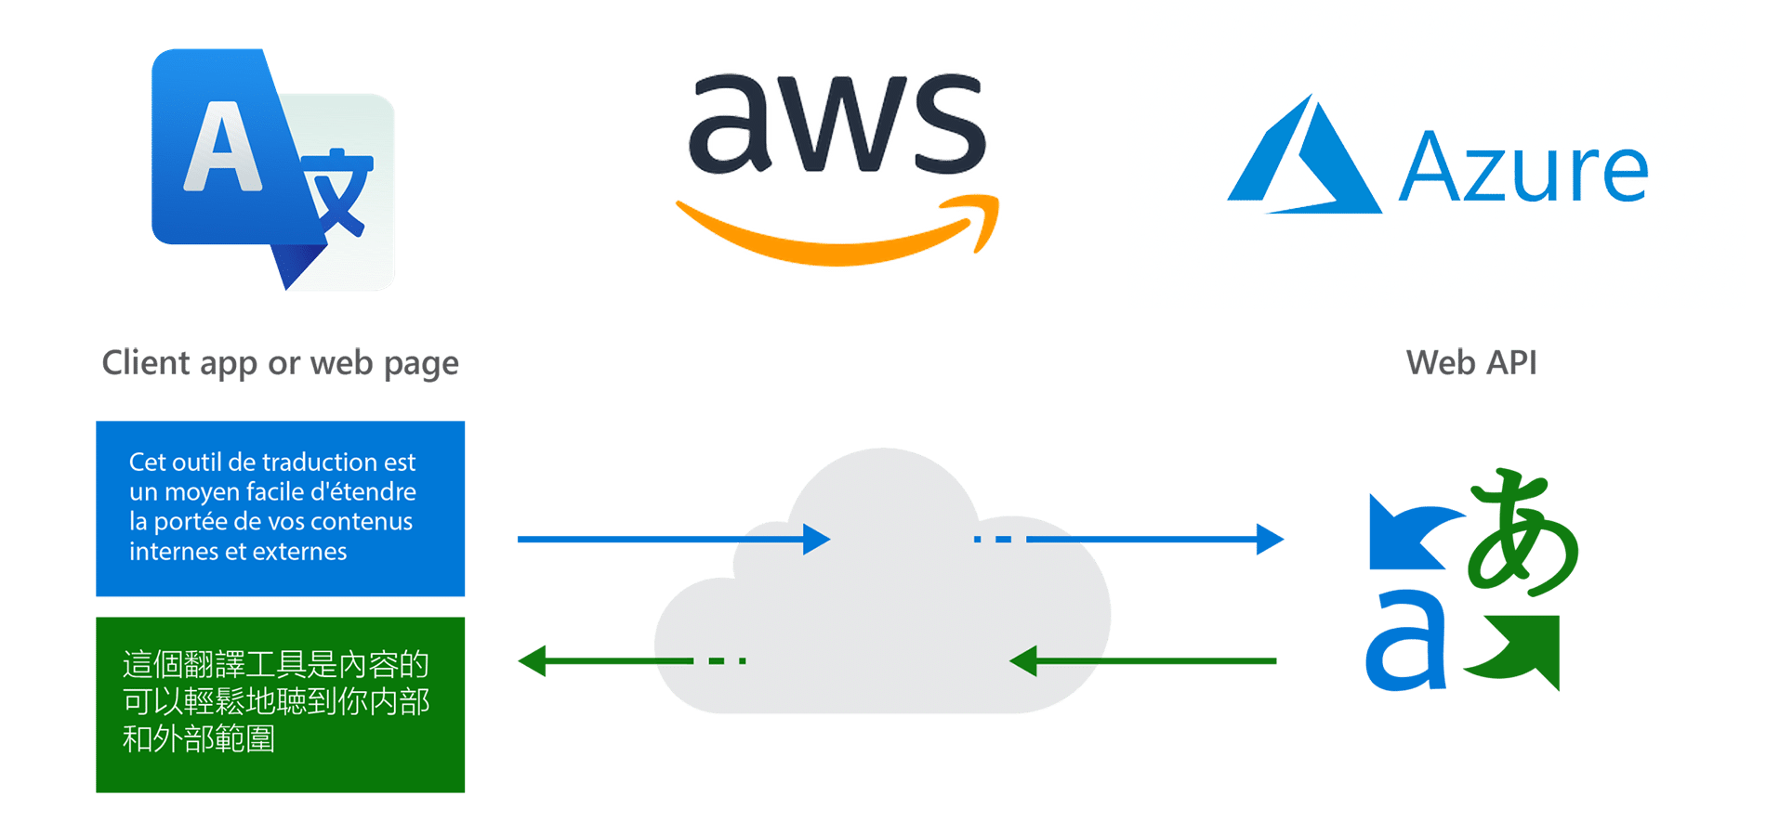

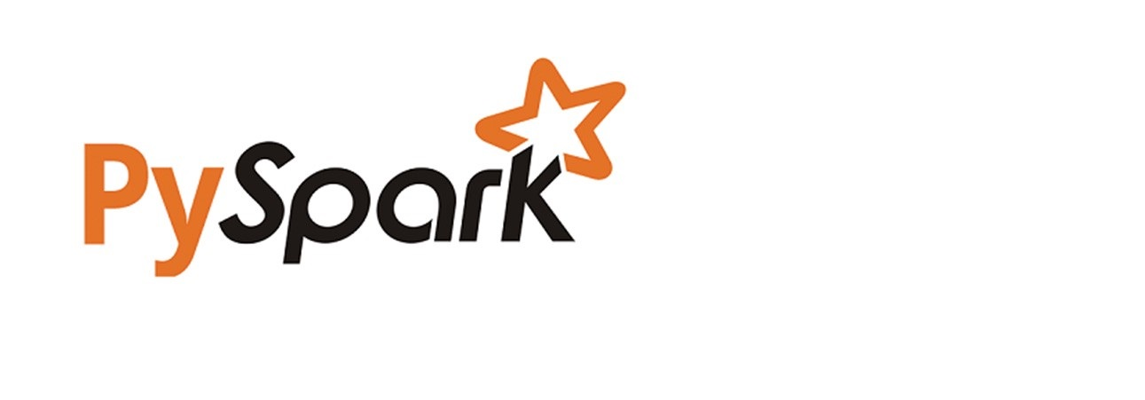


SOURCES, TOOLS AND TECHNOLOGIES

Slide 5



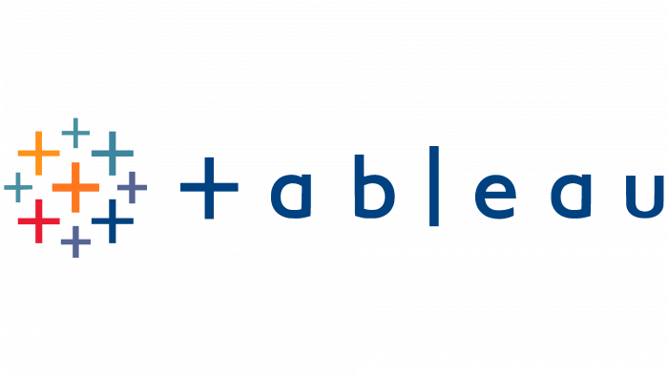
Project Architecture
Twitter API
Source Table
Sentiment Analysis
Target Table
Data Visualization
YouTube API
Extract Data
Data Cleaning, Mining
Write CSV
Csv uploaded
01
02
03
04
05
API
Extract
Databricks
Load
Tableau
API stands for Application Programming Interface. In the context of APIs, the word Application refers to any software with a distinct function.
Here extract the data from YouTube and twitter. And available source table
DataBricks is an organization and big data processing platform founded by the creators of Apache Spark.
Here written data frame to csv
Tableau is a powerful and fastest growing data visualization tool used in the Business Intelligence Industry.

Slide 6
WORKFLOW
Data Visualization
Data Analysis
Data Engineering

Slide 7

DATA
ENGINEERING
PROCESS
DATA COLLECTION
DATA CLEANING
DATA TRANSFORM
DATA PROCESSING
DATA LOADING
TEXT TRANSLATING

Slide 8
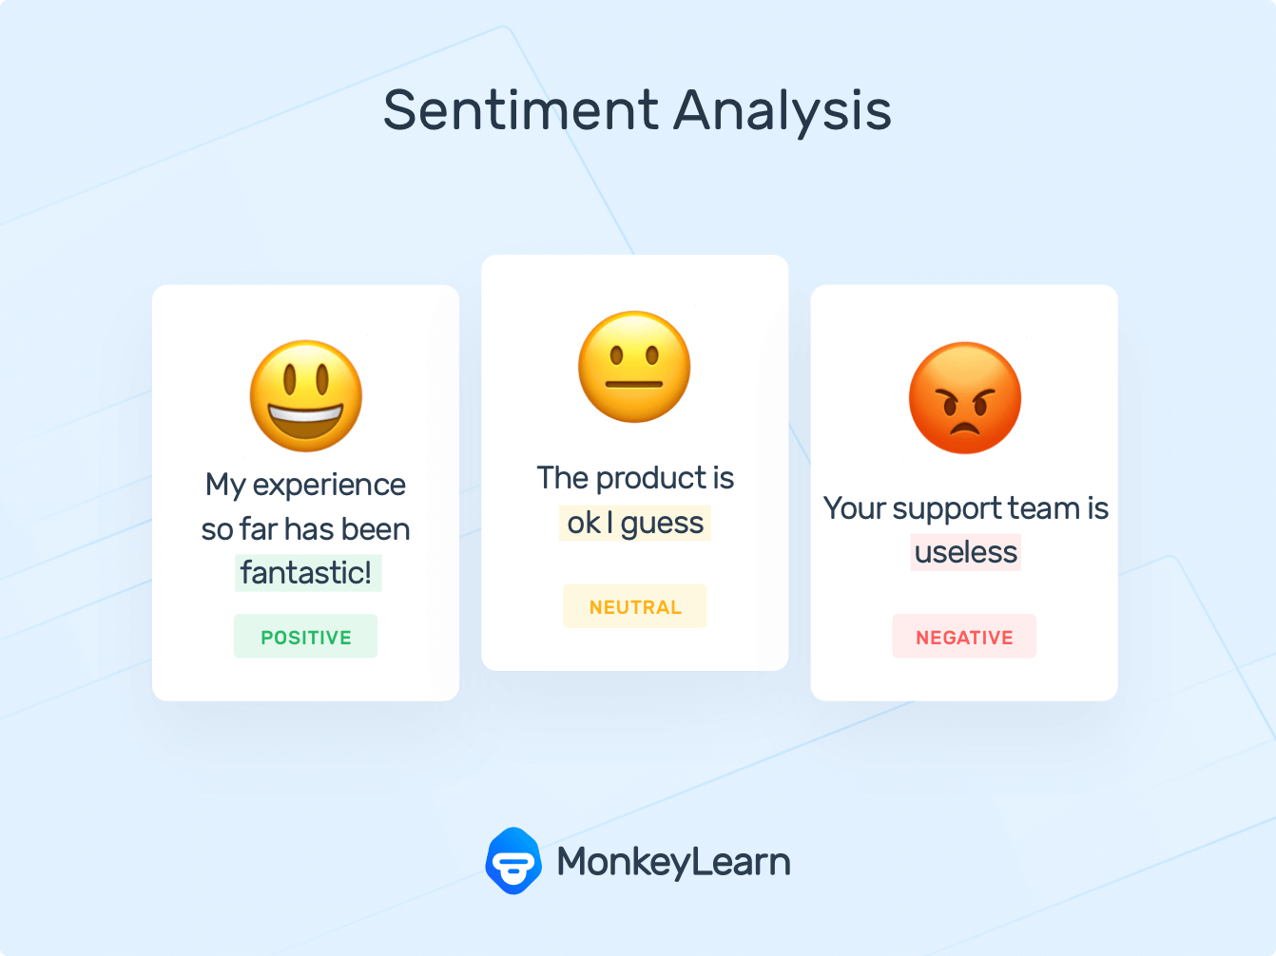
Implementation Sentiment Analysis

Slide 9
Implementation Text Translation

Slide 10
Understanding the dataset and analyzing based on the requirements and finding the insights.
DATA ANALYSIS & VISUALIZATION
The purpose of Data Analysis is to extract useful information from data and taking the decision based upon the data analysis.
An in-depth understanding of data can improve customer experience, retention, targeting, reducing operational costs, and problem-solving methods.

Slide 11
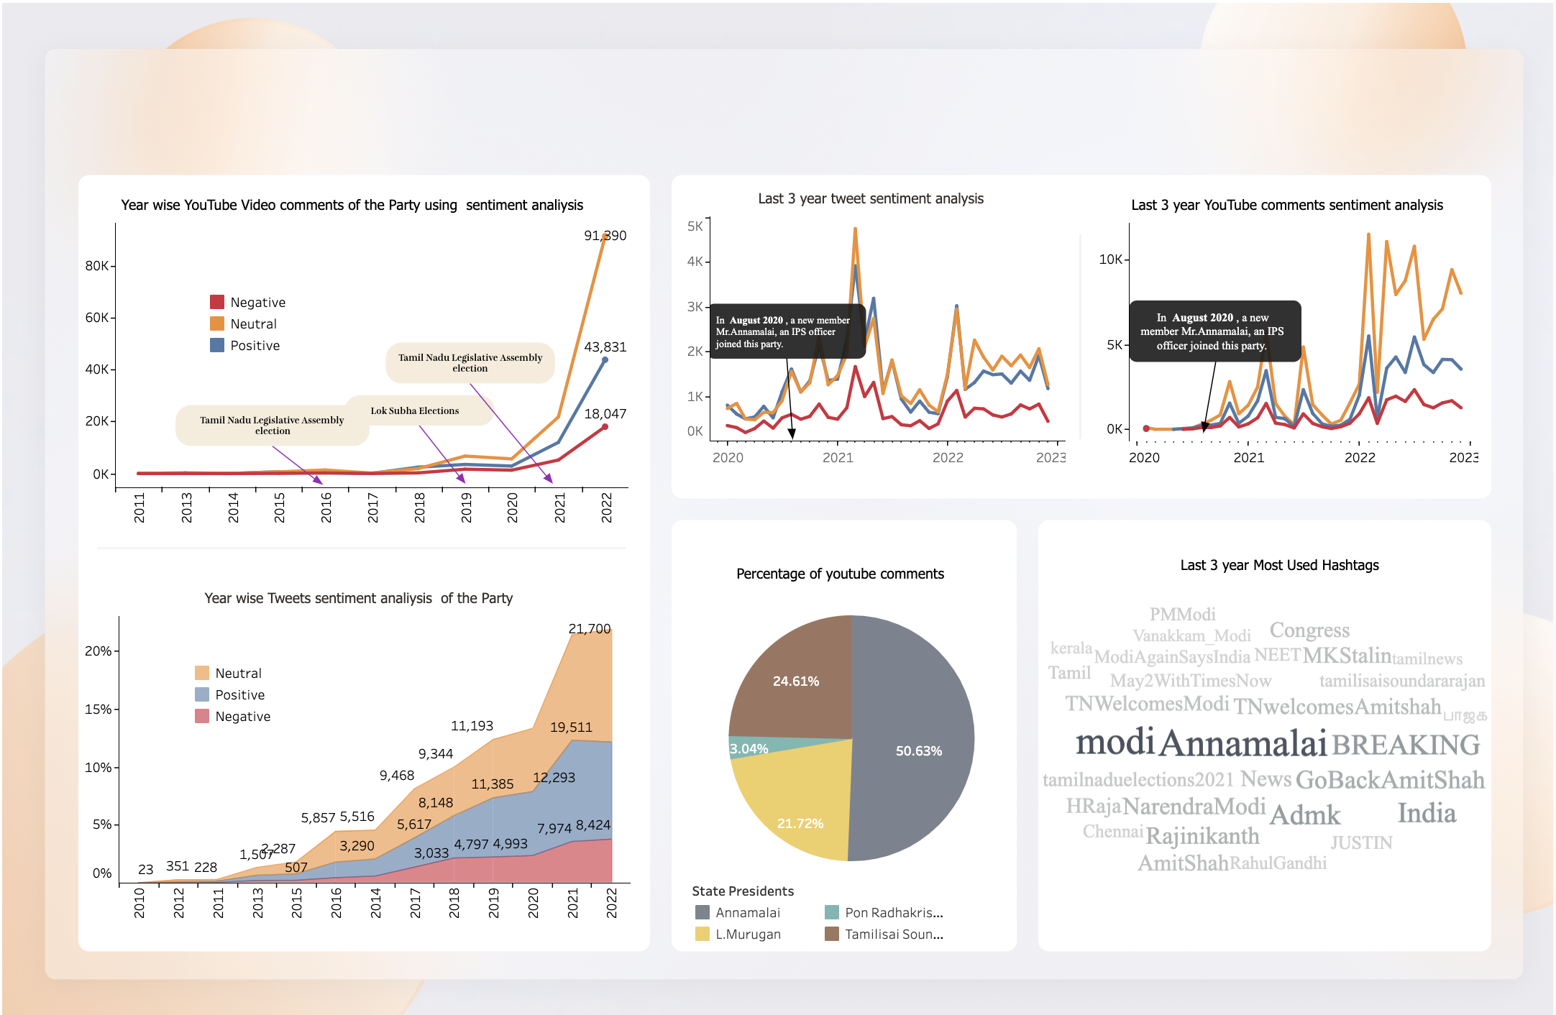
Year Wise YouTube, Twitter sentiment Analysis of the Party

Slide 12
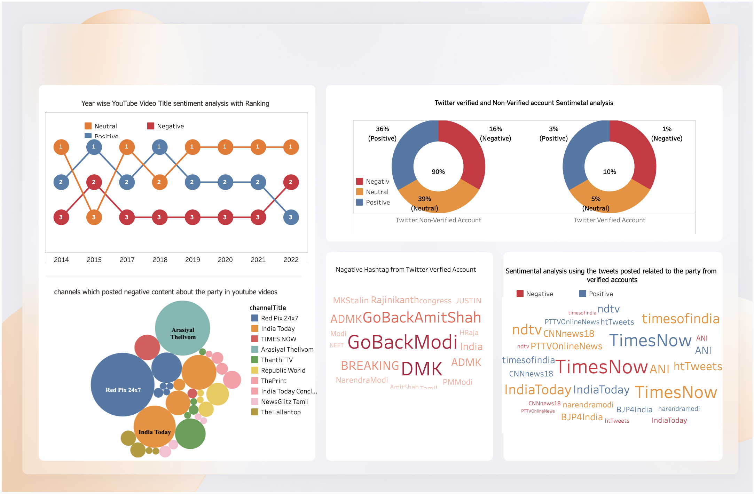
Year Wise YouTube, Twitter sentiment Analysis of the Party
Negative of the party

Slide 13
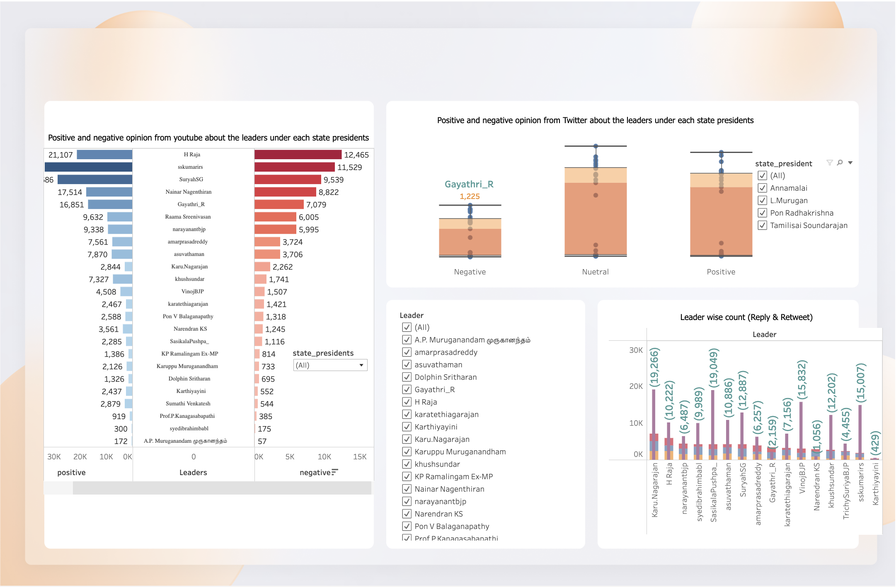
Year Wise YouTube, Twitter sentiment Analysis of the Party
Leaders wise Analysis of the party

Slide 14
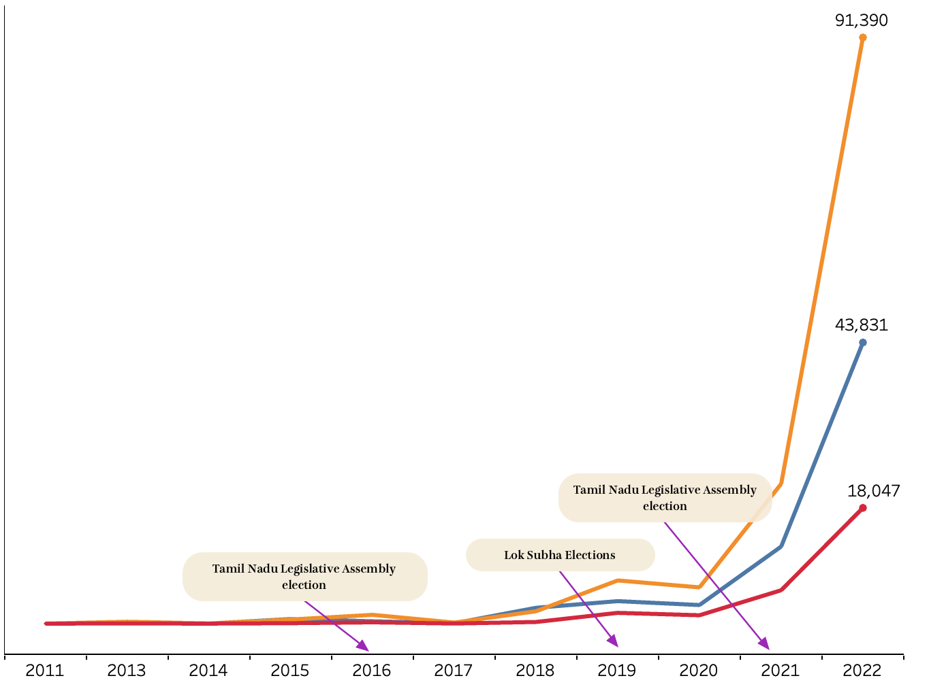
Year wise YouTube Video comments of the Party using sentiment analysis
Since 2011, the active status of the BJP Party on YouTube, while each year's election has increased. During the election campaign, the active status of the party is high because there are going to be a lot of interviews. The active status of this party on YouTube looks equal until 2017. The YouTube active status has increased from 2018 and slightly declined in 2020, and between last 3 year the status range has been gradually increased.

Slide 15
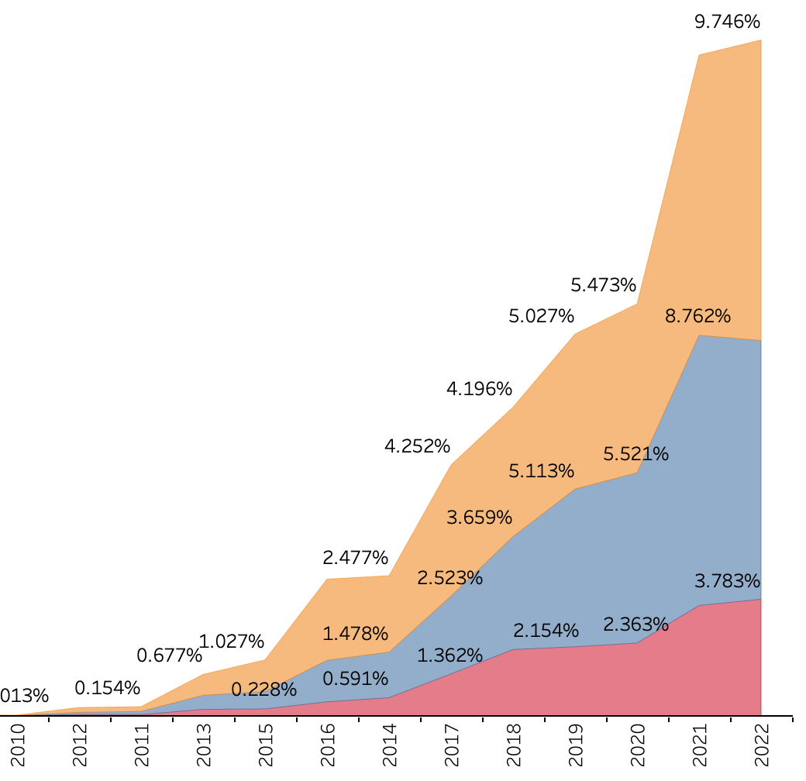
Year wise Tweets sentiment analysis of the Party
On Twitter, the active status of the BPJ Party from 2011 to 2014 increased, with a slight decrease in 2015. From 2016, the active status was gradually increased to 2020, but from Last 3 year, suddenly, the data shows that the active status has been increased.

Slide 16

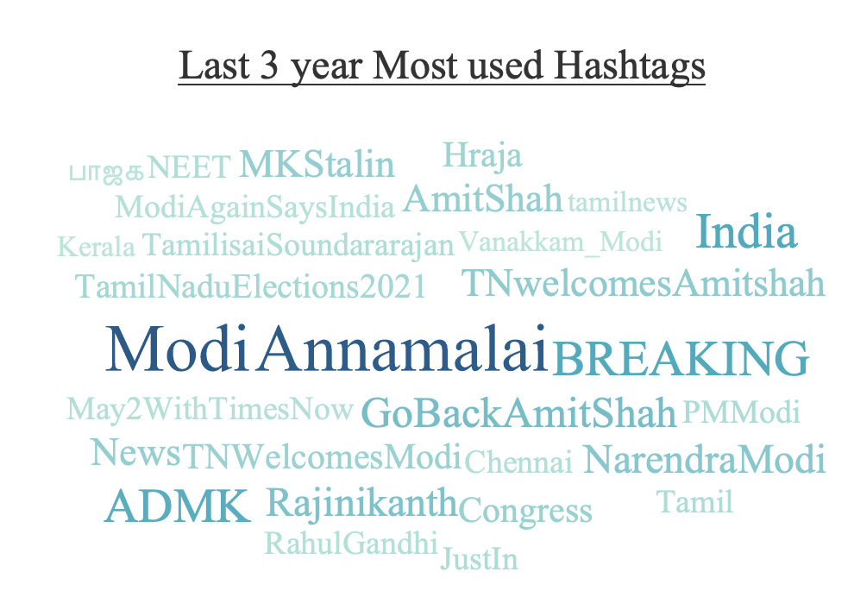
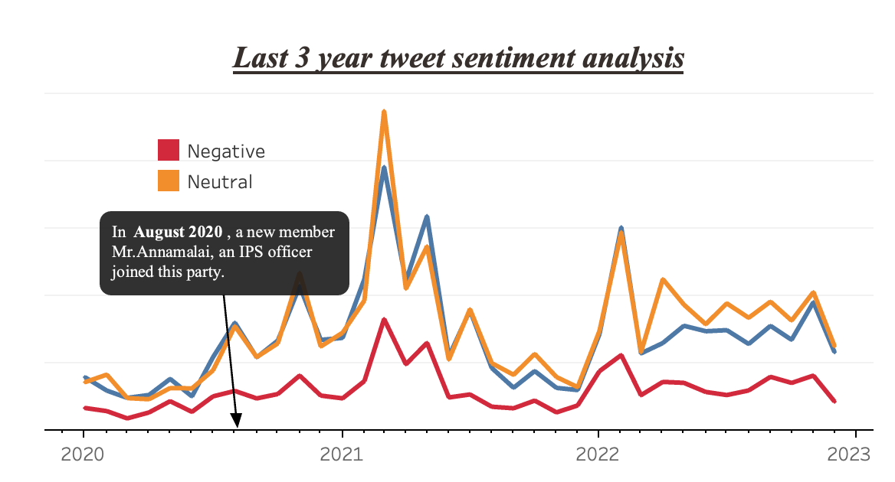
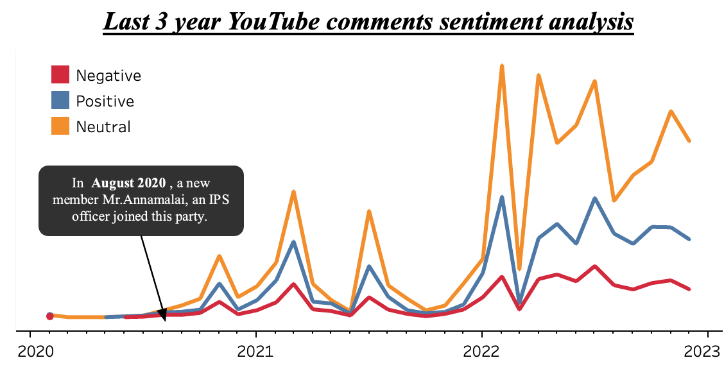
Last 3-year Status
In 2020, Rajinikanth is in talks for entering into politics and also an IPS officer Mr. Annamalai joined as a member in the BJP party. This two incidents in politics led to the increase in the reach of political party among the people.
In the last three years Modi and Amit Shah visited to Tamil Nadu most number of times.

Slide 17
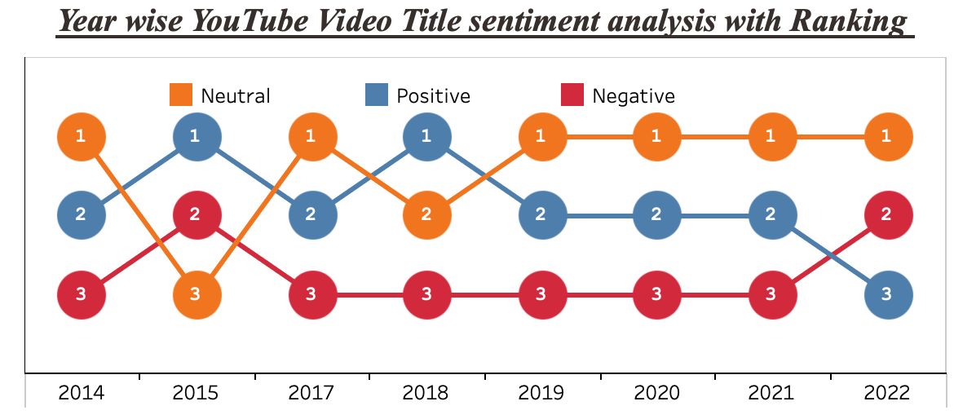
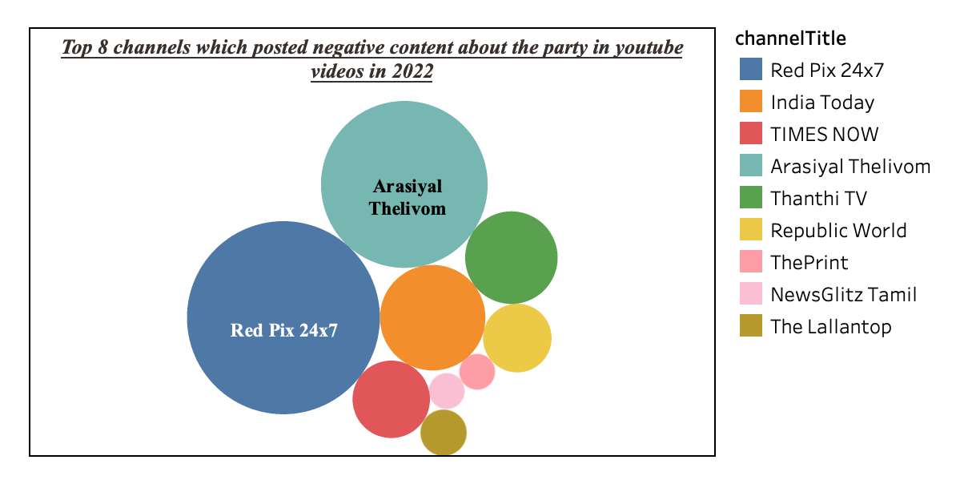
Between 2014 to 2018, positive videos about the party were aired both higher and lower. Between 2019 and 2021, positive videos declined marginally, but by 2022, they declined.
In 2022, the Red Pix 24x7 YouTube channel posted more negative videos against the BJP party.

Slide 18
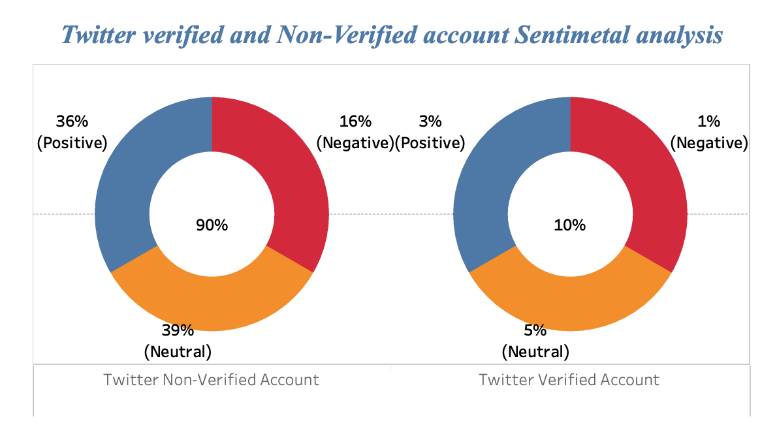

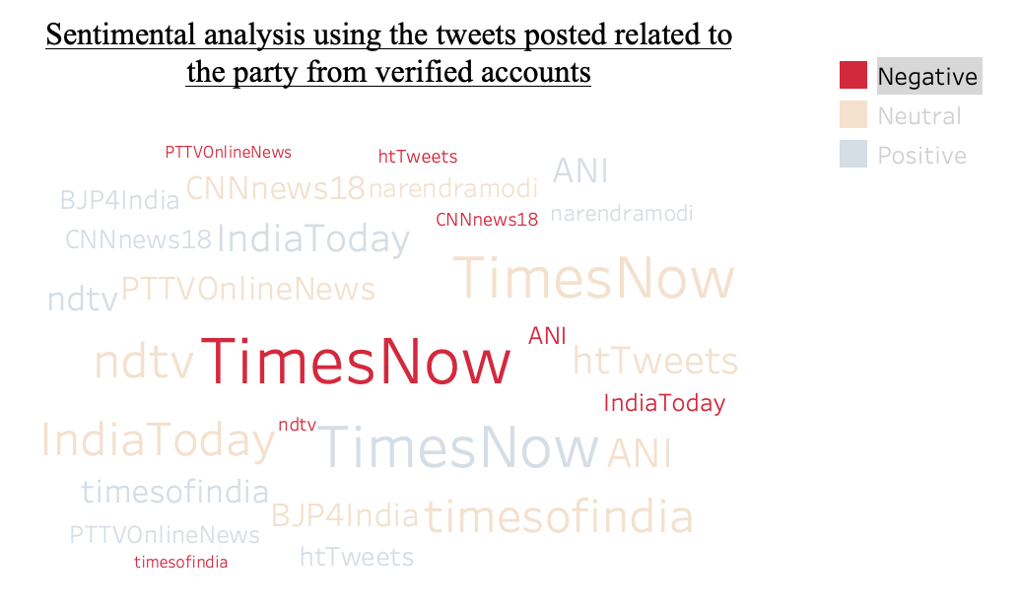
Twitter Blue Tick Account Analysis
From Twitter, I have divided the data into Verified Accounts and Non-Verified Accounts.
I picked Verified Account, which means it has more followers and will reach people soon.
Just 10 percent of Twitter users have a verified account, but the size of this account will be high. Among those 10 percent, 1 percent of Tweet is negative. The negative Twitter account highlighted in red mentioned the three main negative channels here - TimesNow, IndiaToday, and ANI..

Slide 19
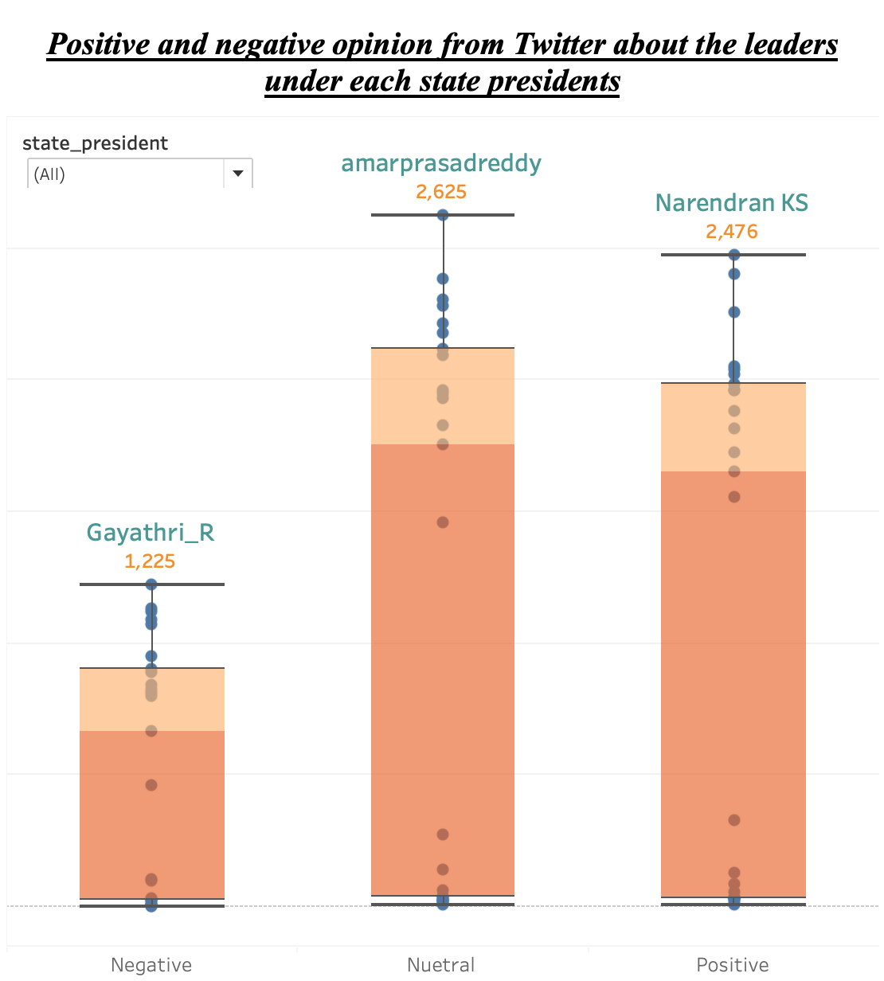
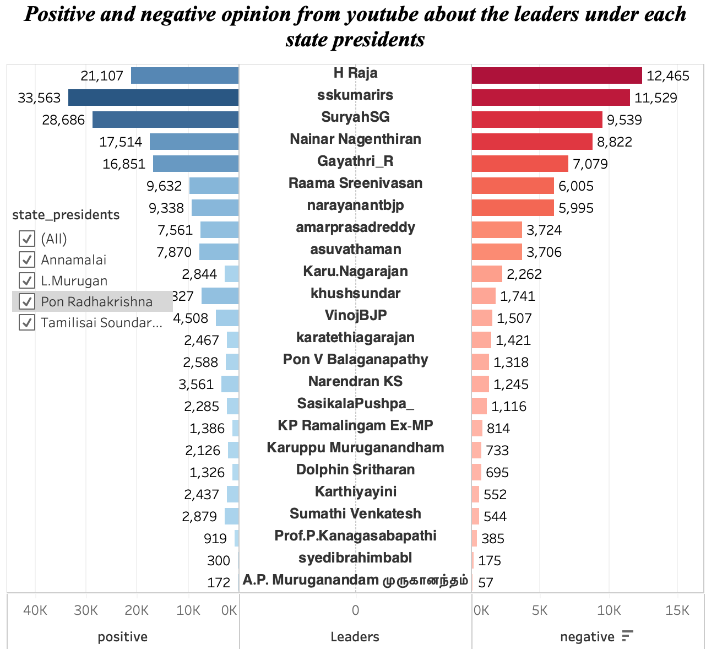
Party Leaders Analysis
This Dashboard shows 23 important leaders in the BJP party their twitter, YouTube videos comments Positive and Negative Feedback.
From 2011, there were four state presidents who have been ruled by this party. Party Leader Activities Positive and negative comments on YouTube videos were shared here.
On the list of the five best leaders, when Annamalai is the current president of the state, there are more negative comments about Nainar Nagenthiran.
But the last time L Murugan was the president of the state there was positive and negative feedback was equal for H Raja. Compared to last time, currently Annamalai is the state president. Now, positive comments are more than negative ones for H Raja.
After Annamalai became the state president, all the leaders in the BJP were the most active.
Whereas four state presidents were governed by this party, compared with other leaders for Gayathri R positive and negative feedback were slightly different. But for the remaining leader, positive and negative comments displayed more differences.

Slide 20
Conclusion
In conclusion with the above analysis, we came to know that after the joining of Mr. Annamalai as a member in the BJP party the reach of the party got increased.
Channels like redfix24/7, TimesNow are against the Tamil Nadu BJP party and spread negative news about them.
Leaders like Gayathri R, H Raja, Nainar Nagenthiran in the BJP party have negative fames among the public.

Slide 21
THANK YOU

